Slide 1
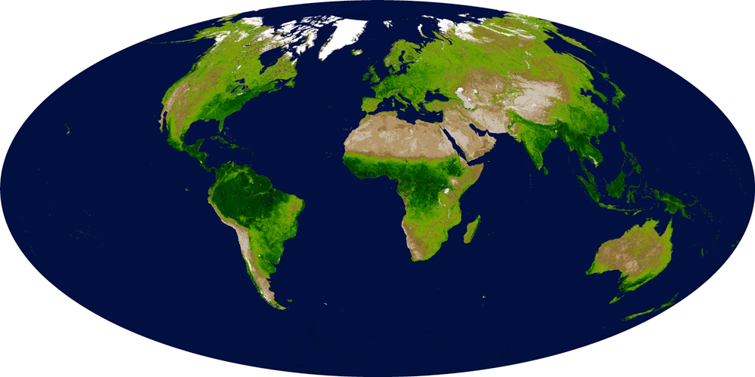
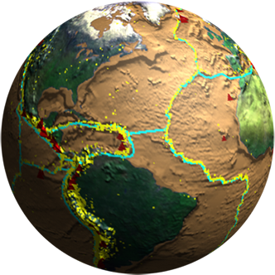
Biodiversity and Ecological Forecasting Team Meeting
Westin Seattle, Seattle, WA
Diversity + Cross-Pollination → Creativity (and Hope)
Woody Turner
Earth Science Division, NASA Headquarters
April 25, 2012
Notes:
Two threads in this talk: 1) we are having a global impact on this planet (and have had for some time) and thus have responsibility for wise and informed management and stewardship of it and 2) diversity of experience and thought enables creativity and thus offers hope as we seek to manage our planet wisely

Slide 2
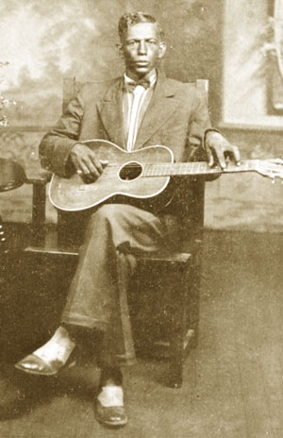
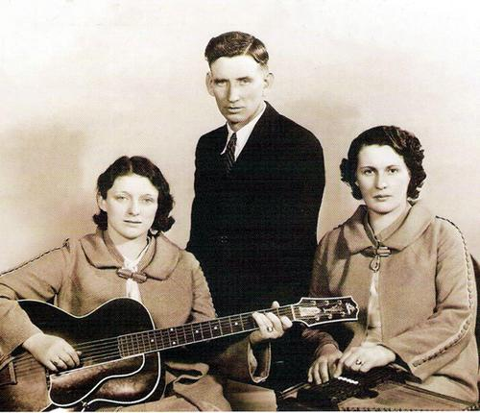
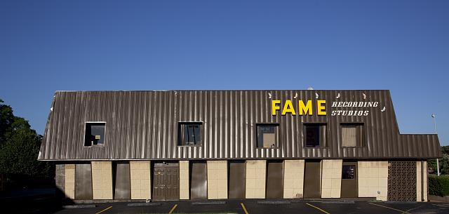
From Roots Music to World Music
FAME Recording Studios in Muscle Shoals, AL by Carol M. Highsmith
Charlie Patton – Delta Bluesman
(source: http://www.goldminemag.com/wp-content/
uploads/2011/02/patton.jpg)
The Carter Family (Maybelle, A.P., Sara) – Folk Musicians
(Source: http://www.carterfamilyfold.org/Graphics/family.jpg)
Notes:
A global species comes together to produce a global music
Patton lived mostly in Sunflower County MS
Carters in southwestern VA

Slide 3
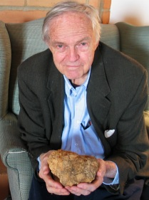
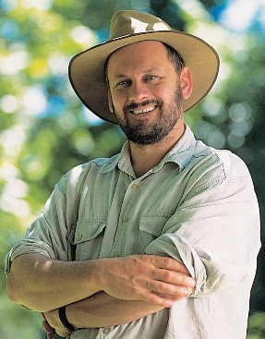
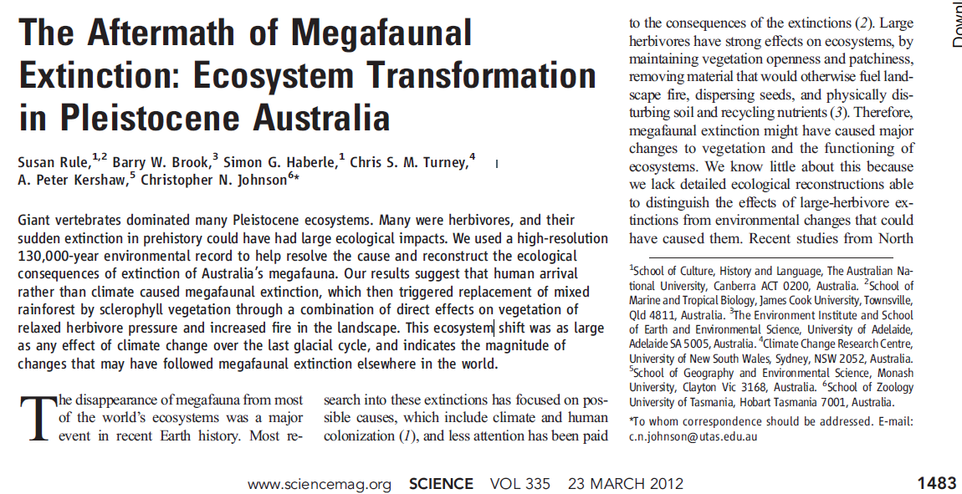
Homo sapiens: a Global Species,
with a Long History Of Global Ecological Impact
Paul S. Martin
(source: http://thegreatstory.org/images/paul-martin-sloth.jpg)
Tim Flannery
(source: http://calitreview.com/images/int_flannery.jpg)
Notes:
Rule et al. (2012) in Science resolved relations among megaherbivore extinction, fire, climate, and vegetation using a 130,000-year record of Sporormiella , pollen, and charcoal from Lynch’s Crater, a paleolake/swamp in Queensland, to show large drops in Sporormiella spores at 41,000 years ago followed by an increase in charcoal and a rise in grasses and sclerophyll vegetation at the expense of rainforest angiosperms and gymnosperms during a time of climatic (and prior to this vegetation) stability.
Flannery: removal of large herbivores promoted fire and led to transition of Australian ecosystems to fire-adapted and poor-soil landscapes
Man is the fire species; whether through external or internal combustion, fire has been Homo sapiens’ primary tool for altering Earth at a global scale

Slide 4
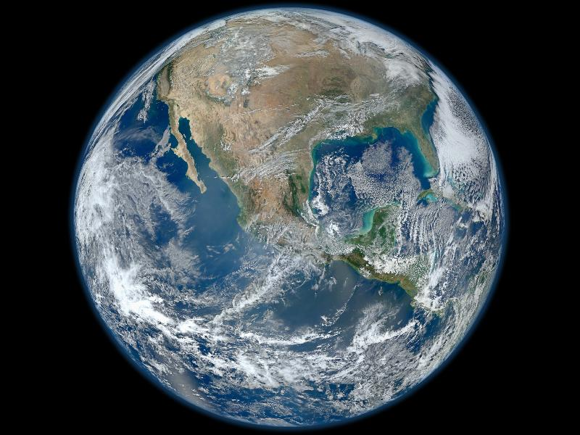
Needed: Global Tools for Global Managers
(credit:NASA/NOAA/GSFC/Suomi NPP/VIIRS/Norman Kuring)

Slide 5
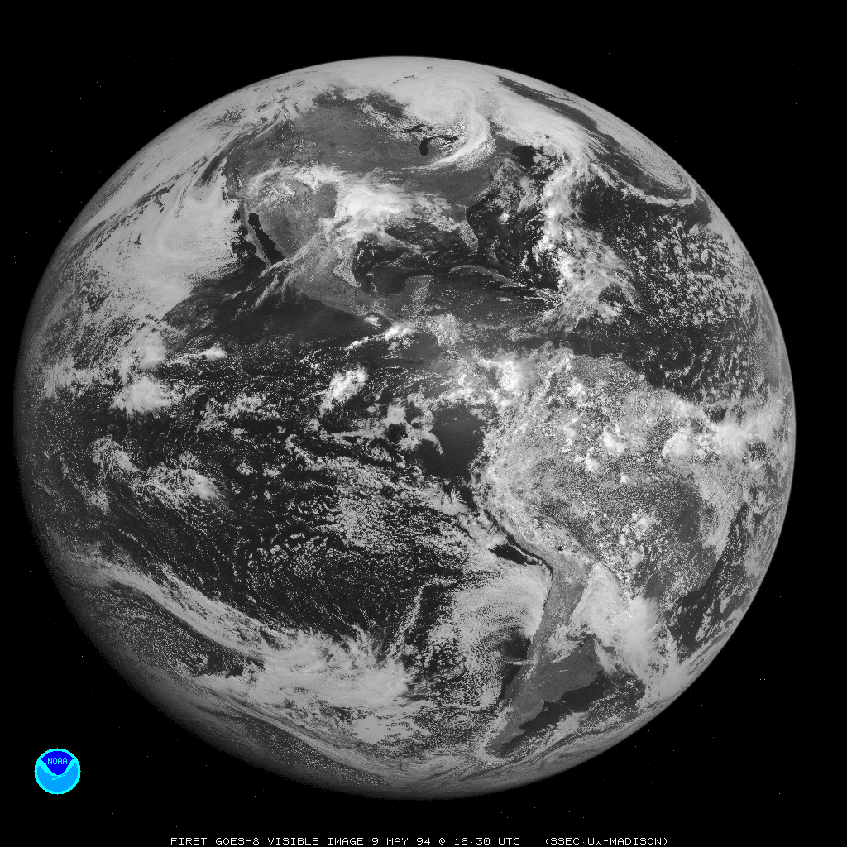
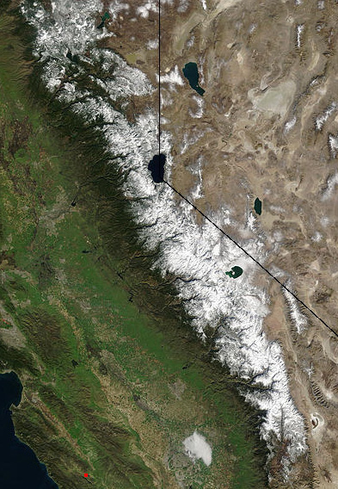
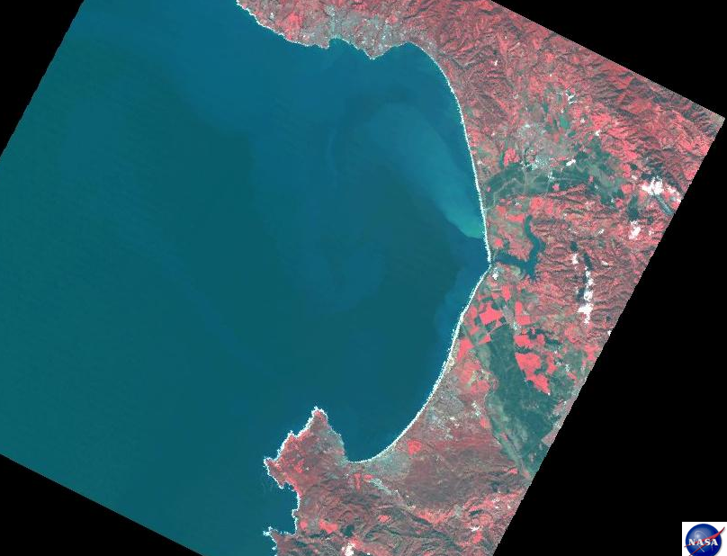
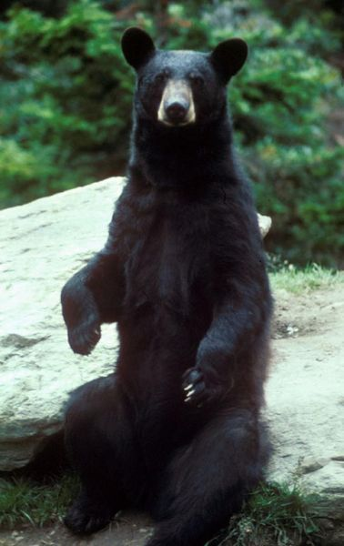
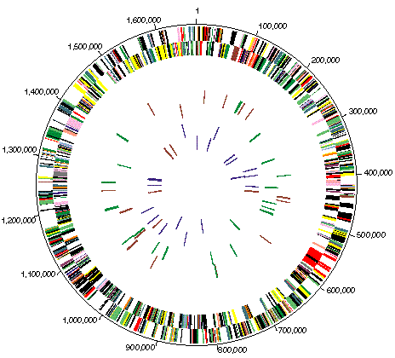
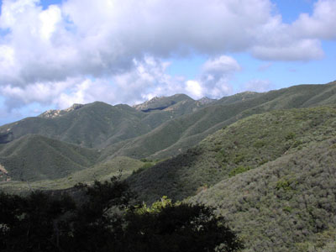
Two Challenges: Scale and Biodiversity Observations
Helicobacterium pylorii Genome from: http://biocrs.biomed.brown.edu/Books/Chapters/Ch%2038/Pylori-Genome.gif
(Source: Wikipedia)
(Source: Wikipedia)
Notes:
spatial and temporal;
time series of biodiversity observations

Slide 6
Meeting Challenges with Creativity
“Creativity is just connecting things.”
Steve Jobs (BrainyQuote)

Slide 7
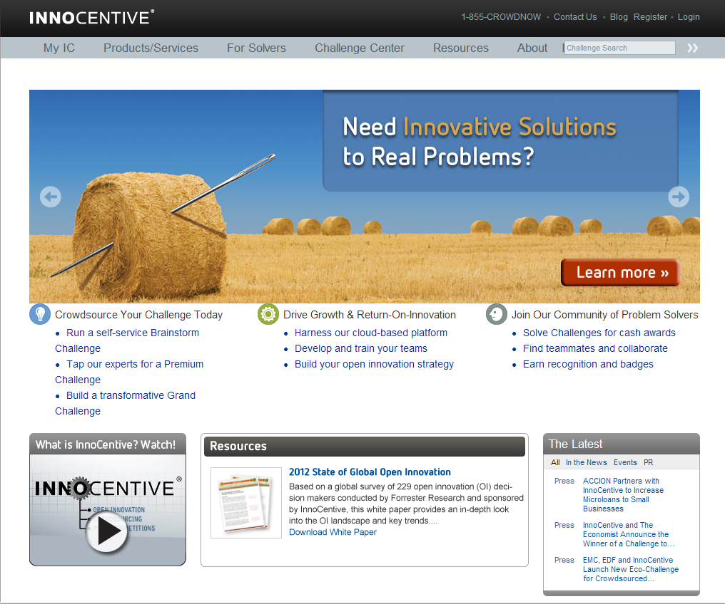
Crowdsourcing: Tool for Creativity and Innovation?
“A lot of people in our industry haven't had very diverse experiences. So they don't have enough dots to connect, and they end up with very linear solutions without a broad perspective on the problem. The broader one's understanding of the human experience, the better design we will have.” Steve Jobs (BrainyQuote)
“Sometimes, the problems were solved within days of being posted online. The secret was outsider thinking: The problem solvers on InnoCentive were most effective at the margins of their own fields. Chemists didn't solve chemistry problems; they solved molecular biology problems. And vice versa. While these people were close enough to understand the challenge, they weren't so close that their knowledge held them back, causing them to run into the same stumbling blocks that held back their more expert peers.
It's this ability to attack problems as a beginner, to let go of all preconceptions and fear of failure, that's the key to creativity.” Jonah Lehrer in
Wall Street Journal, March 10-11, 2012, “How to Be Creative”
Notes:
InnoCentive: a crowdsourcing website where companies post their R&D problems as challenges with a monetary award attached; these are scientific questions organized into 8 categories; nearly 30% of problems posted solved in 6 months (Harvard Business School/Karim Lakhani in WSJ, 5/10-11/2012 Jonah Lehrer article)
Working across disciplines!

Slide 8
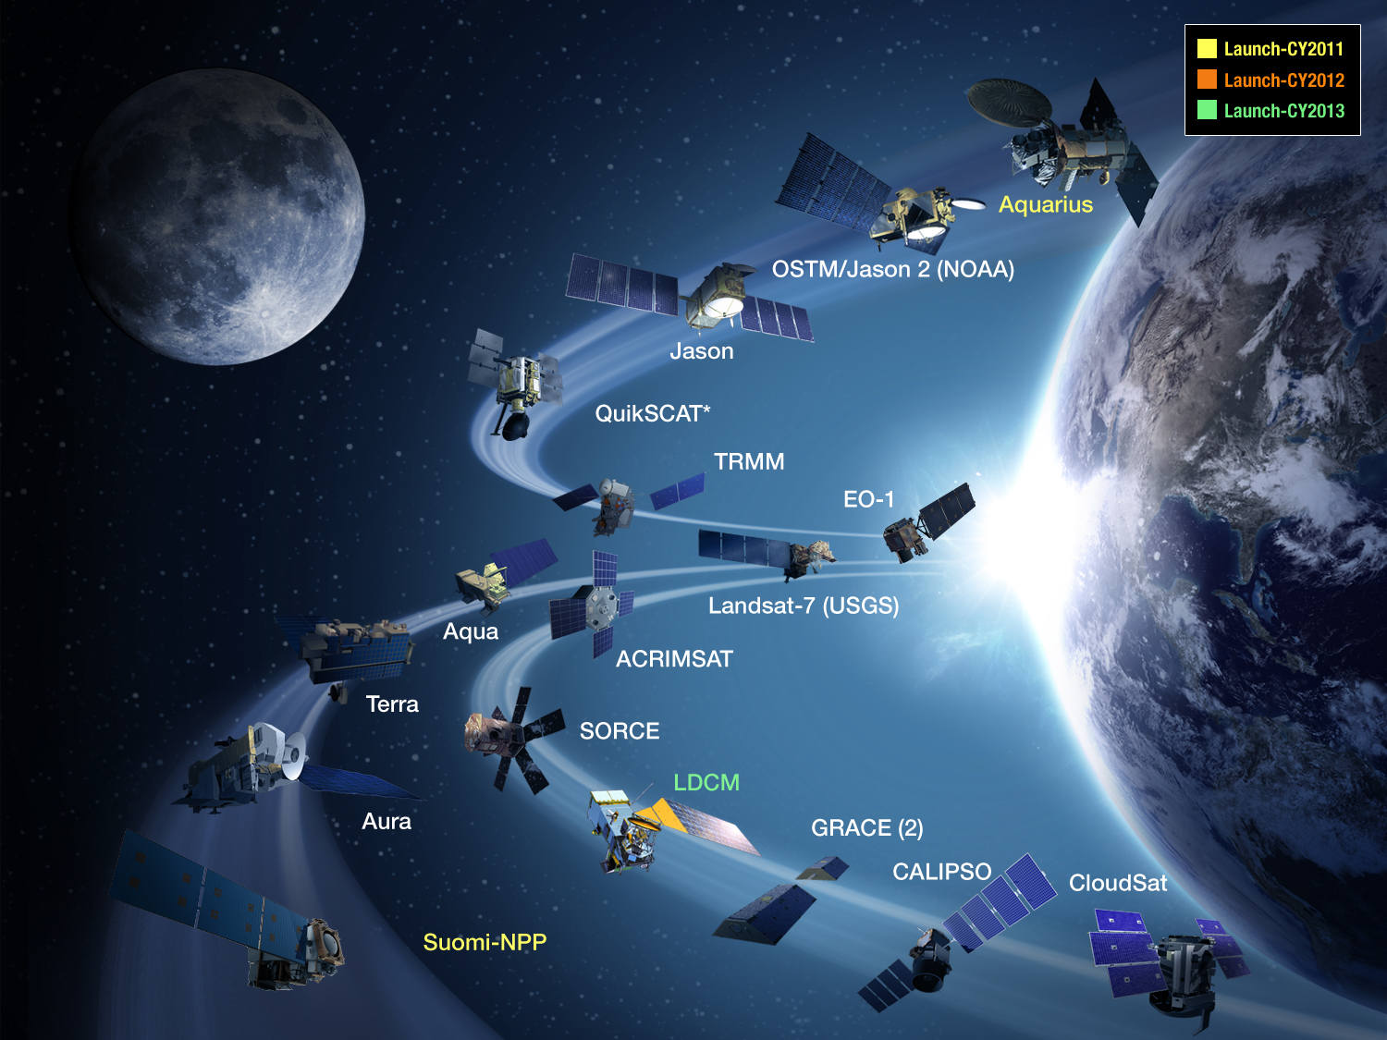
What’s a Mission Agency to Do?

Slide 9
EBVs: Defining Essential Observations
Notes:
First, define what its missions are supposed to look at.

Slide 10
This Team Meeting is our chance to be creative and innovative, to think and work at the margins of our fields with some of the brightest people in the business.
Ultimately, a diversity of disciplines and experience will be key to saving the diversity of life on Earth—in which lies the hope for the future of our global species.
Biodiversity—the evolving variety of Creation—holds the secrets of survival for humanity in the 21st Century.
Notes:
Organization of the meeting
Soak it up: meet, drink, eat, discuss, argue—always working together.

